Slide 1
Java 4 WEB
Lesson 14 - Home Task Overview

Slide 2
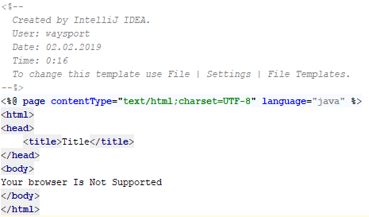
1. Do not commit useless code

Slide 3
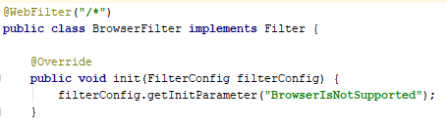
1. Do not commit useless code

Slide 4
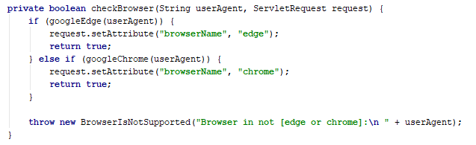
2. Do not mix logical validation with error
Notes:
method should return boolean or throw an exception, but not both

Slide 5
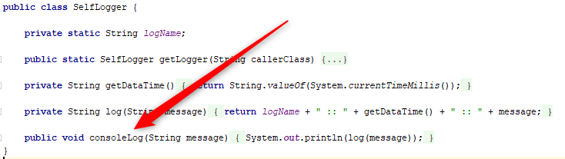
3. Do not repeat yourself
Notes:
Do not repeat source in method name
According to the home taskdata should be logged into file

Slide 6
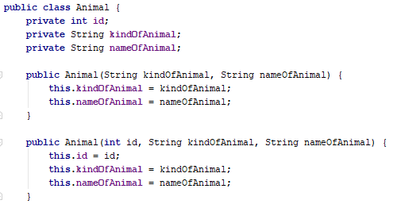
3. Do not repeat yourself
Notes:
Do not repeat type in field name

Slide 7
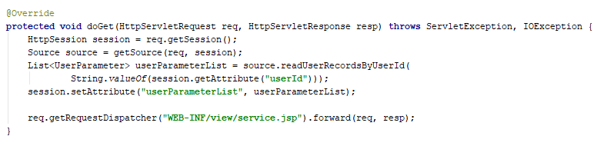
4. Use minimal data-visibility scope
Notes:
Do not put data to session, use request scope

Slide 8
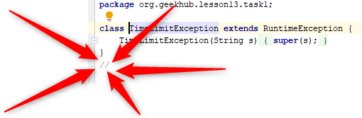
5. Do not commit useless code
Notes:
What is the purpose of this comment?

Slide 9
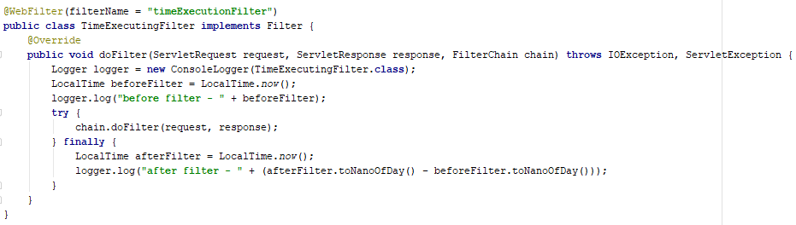
6. Take into account previous issues
Notes:
Filter will log incorrect measures when request started in one day and finished on another

Slide 10
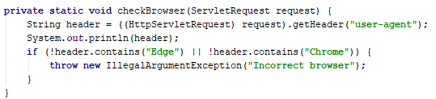
6. Take into account previous issues
Notes:
Event Edge user agent contains word Chrome

Slide 11
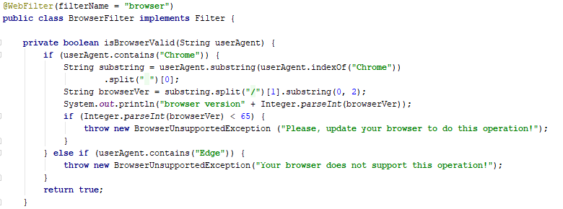
6. Take into account previous issues
Notes:
System out is not allowed operation. Everything should be logged by logger

Slide 12
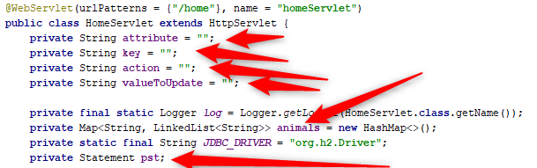
7. App should work with multiple users

Slide 13
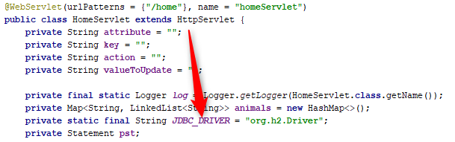
8. Use encapsulation
Notes:
Encapsulate db/sql logic in a separate class

Slide 14
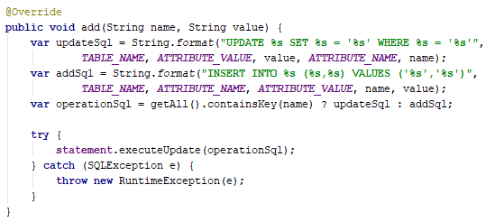
9. Write secure applications
Notes:
use prepared statemnt but not srting format

Slide 15
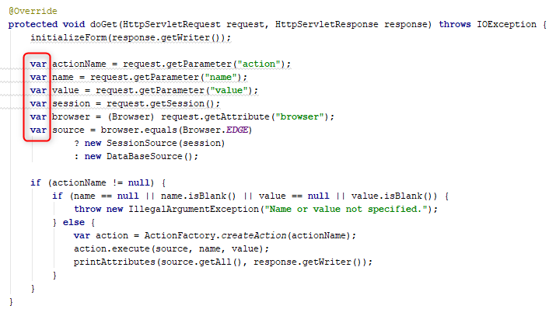
10. Write easy-to-read code
Notes:
define types, use `var` very rarely (only when var is visible on next lines)

